Slide 1
Module 11:
Triggers in MS SQL

Slide 2
Objectives
At the end of the session, you will learn:
Overview of Triggers
Overview and types of DML Triggers
Working with DML Triggers

Slide 3

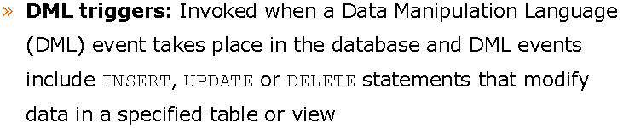
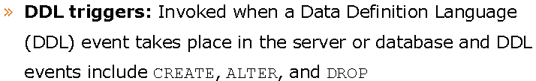
Introduction to Triggers

Slide 4
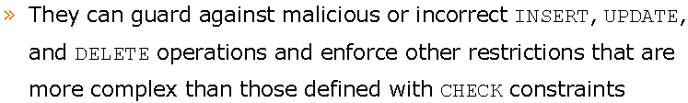
DML Triggers

Slide 5
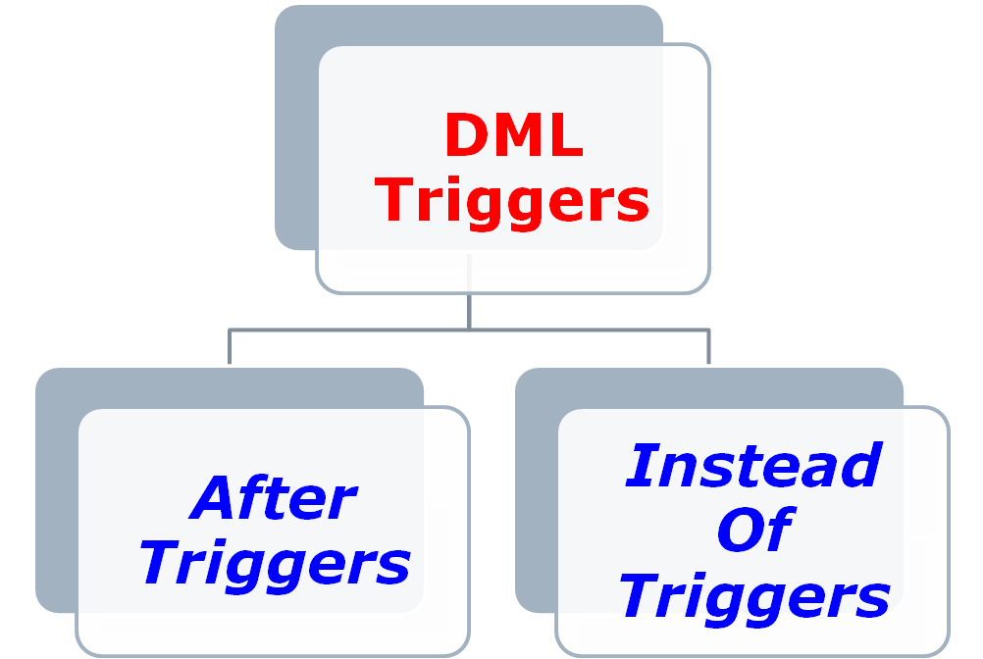
Types of DML Triggers

Slide 6
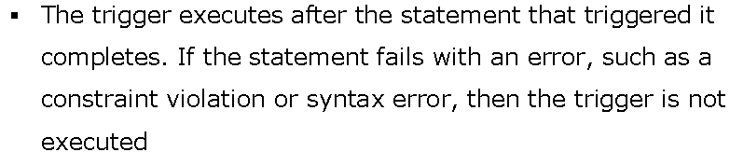
After Triggers

Slide 7
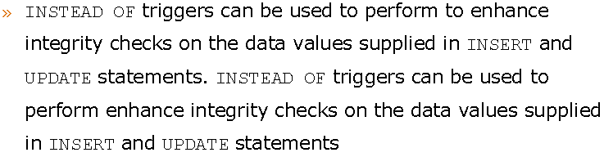

Instead Of Triggers

Slide 8
Thank You…!

